Slide 1


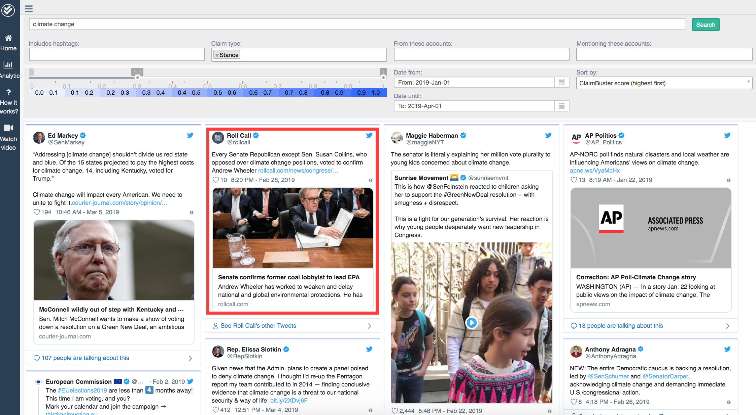
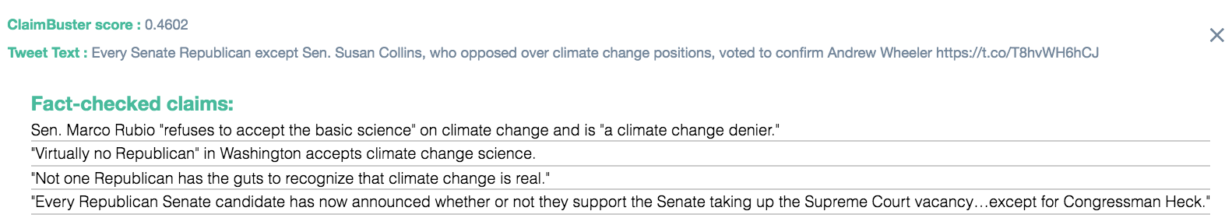
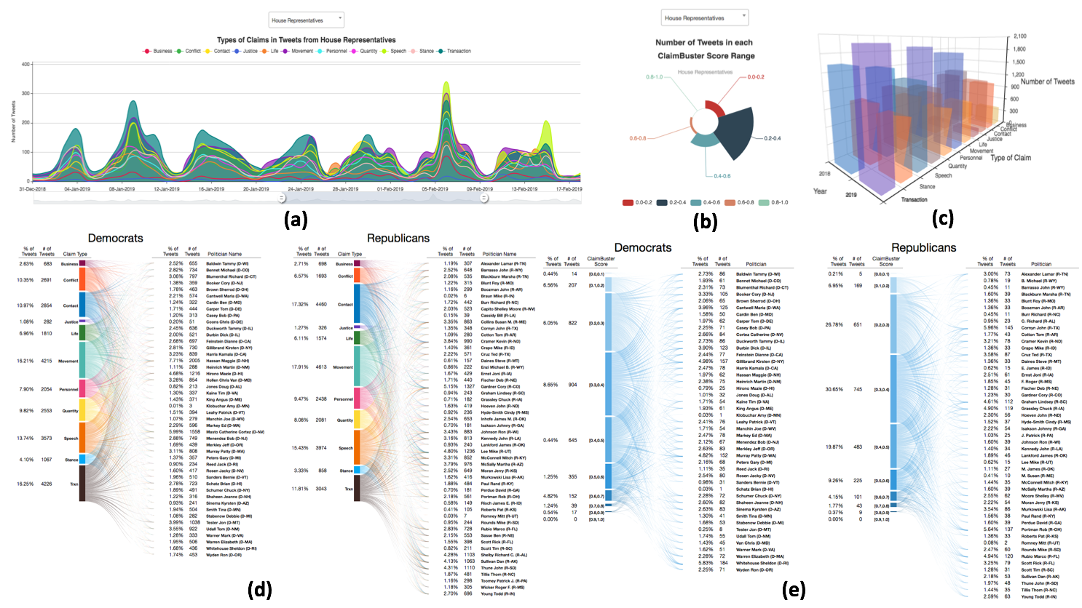
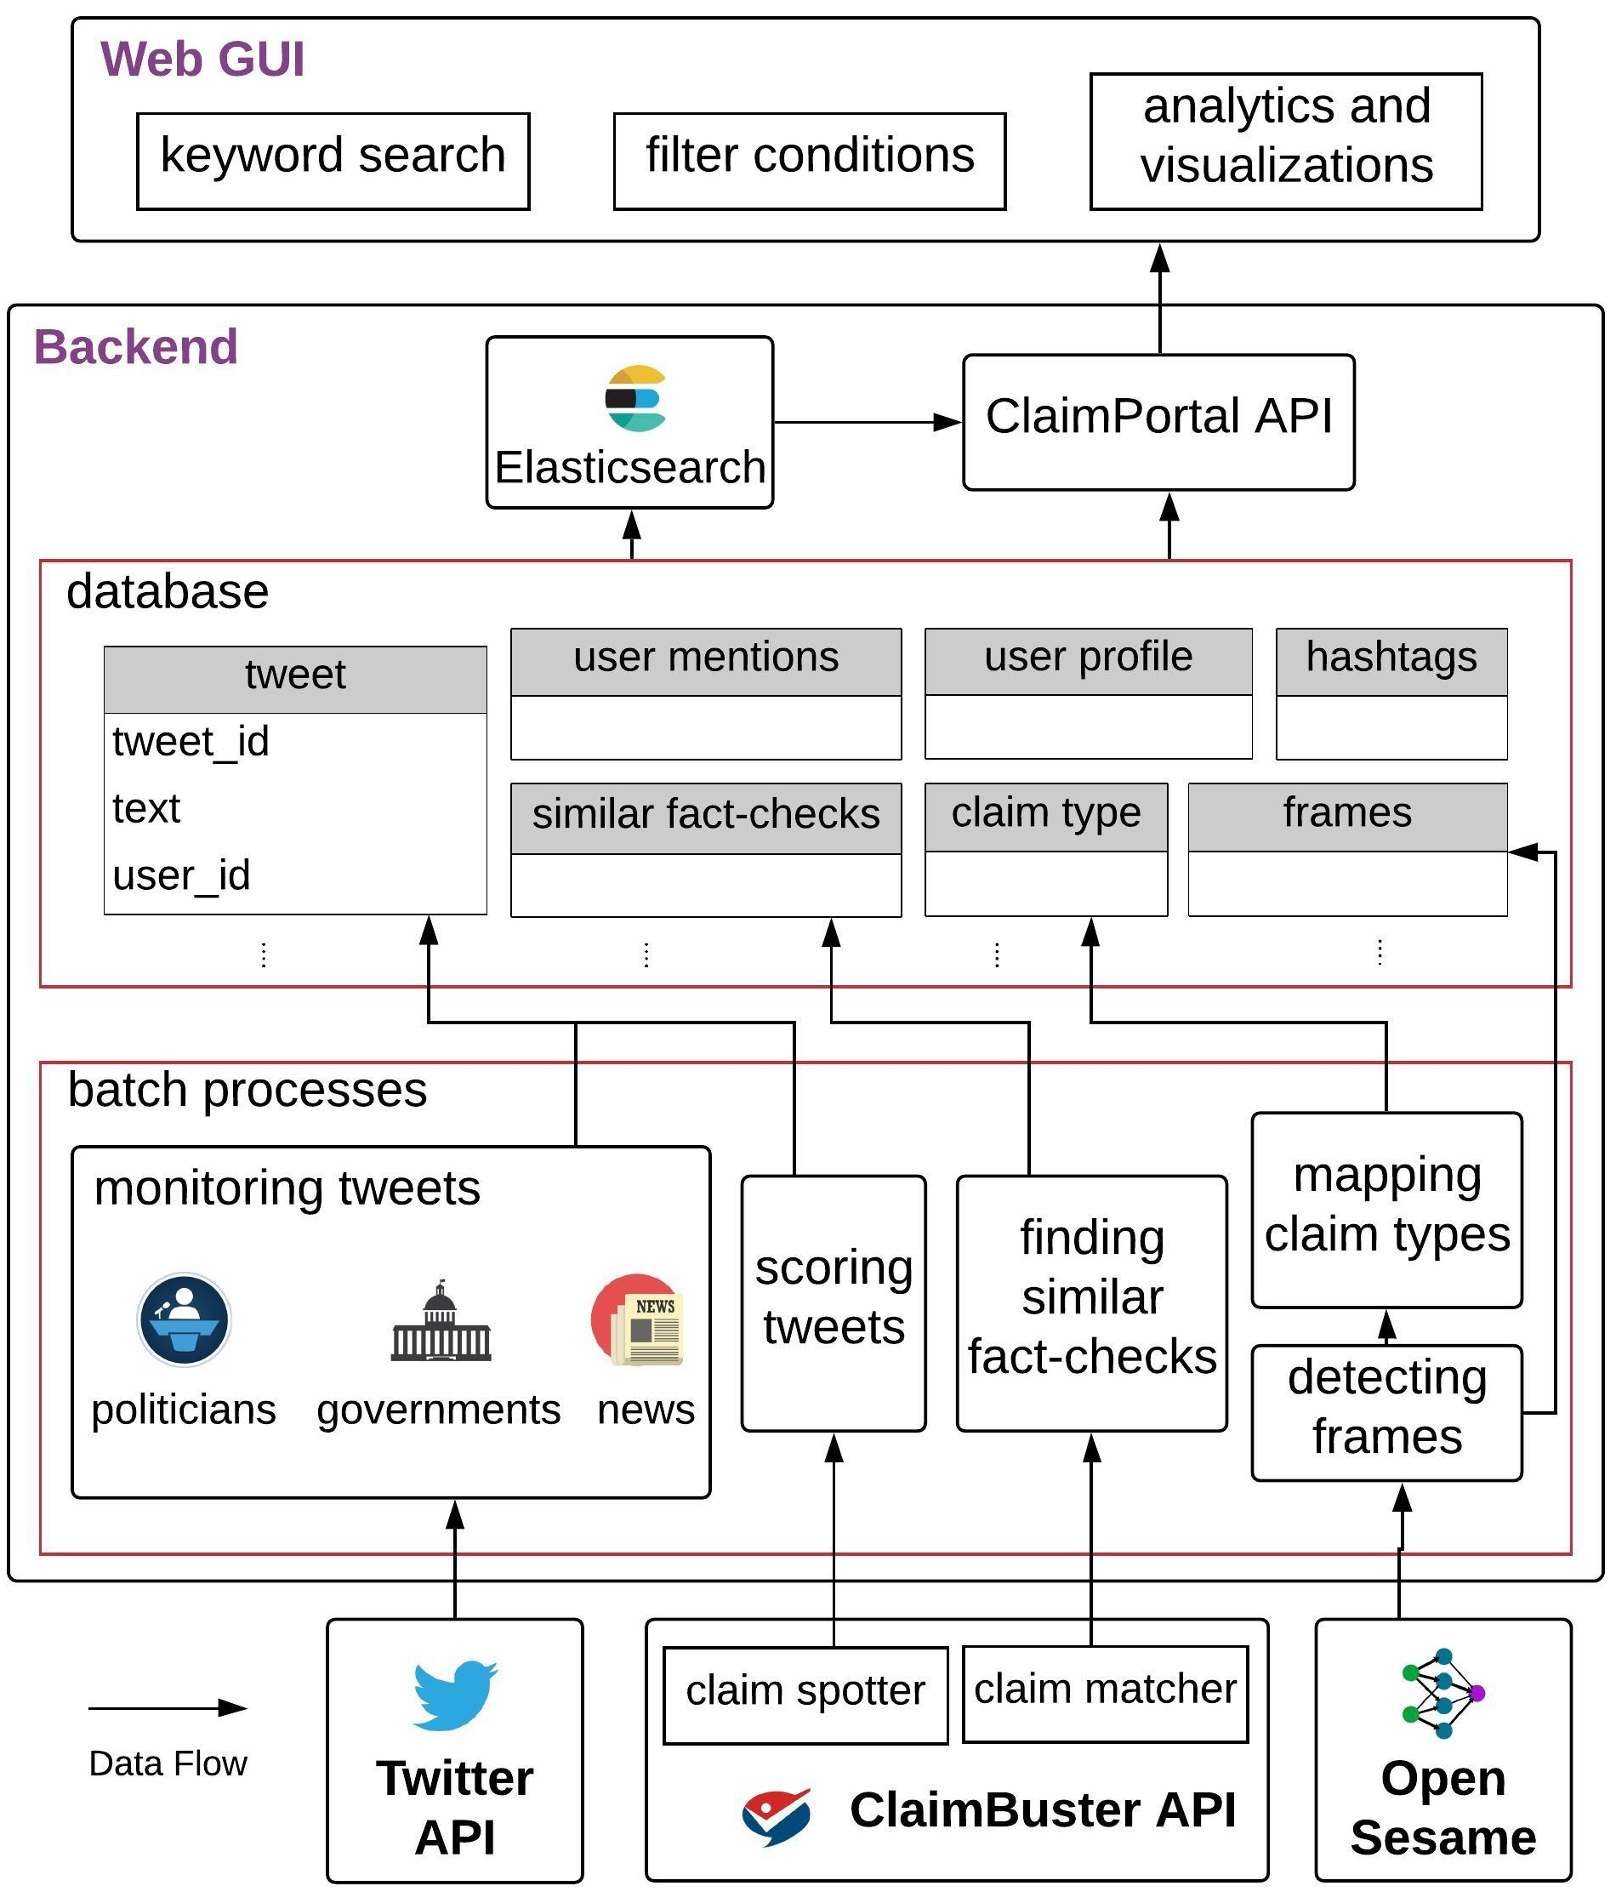
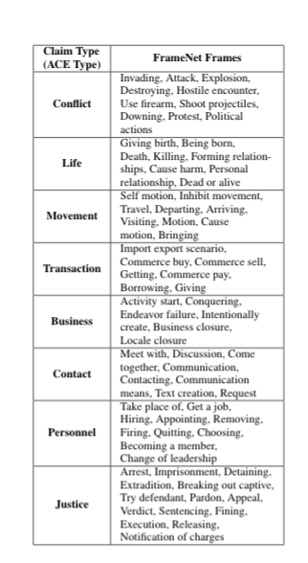

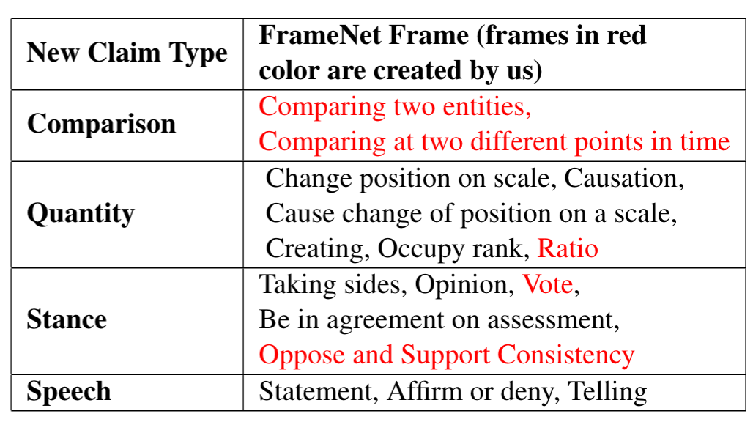


ClaimPortal: Integrated Monitoring, Searching, Checking, and Analytics of Factual Claims on Twitter
Sarthak Majithia, Fatma Arslan, Sumeet Lubal, Damian Jimenez,
Priyank Arora, Josue Caraballo, Chengkai Li
The University of Texas at Arlington
Motivation
What does ClaimPortal do?
The problem of unchecked claims is exacerbated on social media.
Fact-checking every social media post is not possible due to:
laborious and intellectually demanding process
limited resources
sheer volume of data
Assist users to sift through factual claims in tweets.
Allows users to customize their search with a variety of filtering conditions:
Keywords, dates, twitter handles, hashtags, user mentions, claim types, and check-worthiness score.
Provides simple but intuitive analytics and visualizations.
Presents similar fact-checks for a user-selected tweet.
ClaimPortal GUI
ClaimPortal main web page
Similar fact-checks for the highlighted tweet on the main web page
Visualizations on the analytics page
ClaimPortal System Architecture
Claim Type Detection
System
Task: Classifying tweets based on the types of factual claims they promote.
Employed a sub-collection of FrameNet frames.
Created several new factual-claims related frames.
Adopted ACE event types as claim types.
Utilized the study of mapping frames to event types (Spiliopoulou et al., 2017).
Introduced four new event types with their mapped frames.
Used open-sesame for frame detection.
https://idir.uta.edu/claimportal/
Funding

